Slide 1
System Analysis and Design
Unit 4: Design

Slide 2
File Organization and Database Design
File – collection of records related to each other
File Organization – the way data is stored in a file/block/storage medium
refers to physical location of that record in the computer file such as magnetic tape or a disk.
Databases - is a set of interrelated files for real time processing.
Database management system (DBMS)- is a software that creates and manipulates the databases.
allows the creation, modification, and updating of the database; the retrieval of data; and the generation of reports and displays.

Slide 3
Types of organizing files
Sequential Organization
Indexed Sequential Organization
Hashed File Organization
Inverted List Organization
Direct-Access organization

Slide 4
Sequential Organization
records are organized by the order they were entered – stored one after another
May be arranged in the ascending or descending order or chronological order of a key field which may be numeric or both.
Since the records are ordered by a key field, there is no storage location identification.
Order of record is fixed
Can be read and written only sequentially not randomly
To add record in the middle of the file, one have to rewrite the whole file

Slide 5
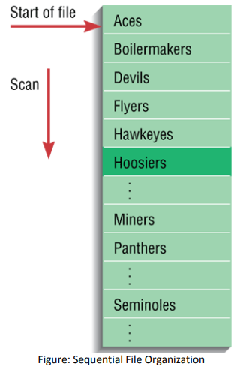
are normally created and stored on magnetic tape using batch processing method.
Eg, payroll management

Slide 6
Indexed Sequential Organization
data are stored sequentially on a file (i.e. magnetic disk) using primary key
Index value is generated for each primary key and mapped to with record
suitable for both batch processing and online processing.
speed up access to the records as data is accessible randomly and sequentially.
Indexing permit access to selected records without searching the entire file.
Index – a table is used to determine the location of rows in a file that satisfy some condition.
Secondary Index - Index based upon a combination of fields (columns) for which more than one row may have same combination of values.

Slide 7
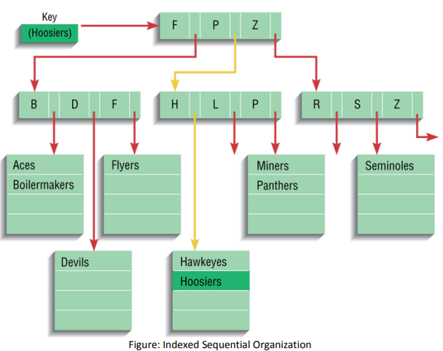

Slide 8
Hashed File Organization
random access to a file or database.
Uses combination of hash function
i.e. A hash function is computed on some attribute of each record.
specifies the location of the record to be placed.
the address for each row is determined using an algorithm.

Slide 9
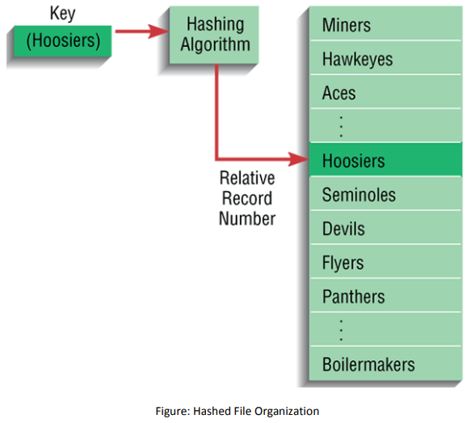

Slide 10
A hash function converts given alphabetic or numeric value to small practical integer value
Key
Ram
Sam
Hari
Hash function
Hashes
00
01
02

Slide 11
Inverted List Organization
Like the indexed-sequential storage method, the inverted list organization maintains an index.
Difference - indexed-sequential method has a multiple index for a given key type,
whereas inverted list method has a single index for each key type.
In an inverted list, records are not necessarily stored in a particular sequence.
They are placed in the data storage area, but indexes are updated for the record keys and location

Slide 12
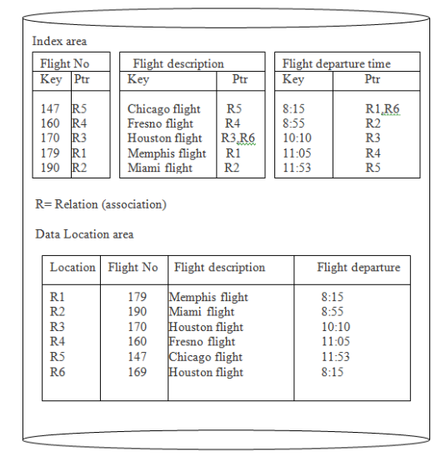

Slide 13
Direct-Access Organization Files
Data are stored in direct access storage devices such as hard disk
directly locate the record without having to search through any other record first.
records are stored randomly, hence the name random file.
It uses online system where the response and updating are fast

Slide 14
Designing Forms and Reports
Forms are used to present or collect information on a single item such as a customer, product, or event.
Forms can be used for both input and output.
Reports, on the other hand, are used to convey information on a collection of items.
are identified during requirements structuring

Slide 15
Process of Designing Forms and Reports
Designing forms and reports is a user-focused activity that typically follows a prototyping approach.
First, you must gain an understanding of the intended user and task objectives by collecting initial requirements during requirements determination.
During this process, several questions must be answered.
These questions attempt to answer the “who, what, when, where, and how” related to the creation of all forms and reports as given below:

Slide 16
1. Who will use the form or report?
2. What is the purpose of the form or report?
3. When is the form or report needed or used?
4. Where does the form or report need to be delivered and used?
5. How many people need to use or view the form or report?

Slide 17
General Formatting Guidelines
Meaningful titles – Titles should be clear and specific describing content and use. They should include version information and current date.
Meaningful information – Forms should include only necessary information with no need to modification.
Balance of layout – Adequate spacing and margins should be used. All data and entry fields should be clearly labeled.
Easy navigation system – Clearly show how to move forward and backward. Clearly show where you are (e.g., page 1 of 3) currently. Notify the user when on the last page of a multipaged sequence

Slide 18
Designing Interfaces and Dialogues
Interface design focuses on how information is provided to and captured from users;
dialogue design focuses on the sequencing of interface displays.
Dialogues are analogous to a conversation between two people.
Thus, the design of interfaces and dialogues is the process of defining the manner in which humans and computers exchange information.
A good human computer interface provides a uniform structure for finding, viewing, and invoking the different components of a system.

Slide 19
Designing Layouts
Header information
Sequence and time-related information
Instruction or formatting information
Body or data details
Totals or data summary
Authorization or signatures
Comments

Slide 20
Designing dialogue
The dialogue design process consists of three major steps:
Designing the dialogue sequence
Building a prototype
Assessing usability

Slide 21
Interaction methods and devices
Methods of Interacting incudes:
Command language interaction
Menu Interaction
Form interaction
Object based interaction
Natural language interaction

Slide 22
1. Command language interaction:
This type of interaction requires users to remember command syntax and semantics.
The user enters explicit statements to invoke operations within system.
2. Menu Interaction
A menu is simply a list of options.
When an option is selected by the user, a Invoked.
Menus are the most widely used interfaces for Interaction.

Slide 23
3. Form interaction
It allows users to fill on the blanks when working with a system.
important and effective for both the input and presentation.
4. Object-based interaction
Uses icons is the most common method for implementing object-based interaction.
Icons are graphic symbols
takes little space and can be quickly understood by users.
5. Natural language Interaction
Is being applied with both keyboard and voice entry systems.

